Slide 1


Predicting Health Insurance Premiums Using Machine Learning
A Data-Driven Approach by :-
Vineet Reddy Saddi
Shiva Kotagiri
Svamsee Addaguduru
Prakash Sai Alla
Saleeq Sunil
Using demographic and medical risk indicators to predict annual health insurance premiums
Notes:
This project focuses on predicting health insurance premiums using machine-learning techniques. We use demographic and medical health-related features to understand what drives premium prices and build a model that predicts them accurately. This presentation covers our dataset, exploratory analysis, modeling approach, results, and business implications

Slide 2

PROBLEM STATEMENT
Understanding and predicting insurance premium costs using demographic and lifestyle factors.
Why Premium Prediction Matters
Health insurance pricing must balance fairness for customers and risk management for insurers.
Medical conditions significantly influence premium amount — making pricing complex and data-driven.
Insurers often struggle to set premiums that reflect true health risk without overcharging.
Problem We Aim to Solve
How can we accurately predict health insurance premiums using demographic and medical indicators?
Can a machine-learning model estimate PremiumPrice before underwriting?
Which features (age, surgeries, chronic diseases, BMI, etc.) most strongly impact premium levels?
Notes:
In this section, we define the business importance of premium prediction and clearly state the problem we aim to solve. Insurance pricing depends on an individual’s health risk profile, but estimating this accurately can be difficult. Our goal is to build a regression model that predicts premium amounts using demographic and medical features. This helps insurers price policies fairly while managing risk, and also improves transparency for customers.

Slide 3

Column | Description
Age | Age of the applicant( in numbers)
Diabetes | Diabetes history (0 = No, 1 = Yes)
BloodPressureProblems | Blood pressure issues (0/1)
AnyTransplants | History of organ transplant (0/1)
AnyChronicDiseases | Chronic illness history (0/1)
Height | Height of the applicant( in numbers)
Weight | Weight of the applicant( in numbers)
KnownAllergies | Any known allergies (0/1)
HistoryOfCancerInFamily | Family cancer history (0/1)
NumberOfMajorSurgeries | Count of major surgeries( in numbers)
PremiumPrice | Target – health insurance premium ( in numbers)
DATASET OVERVIEW
About the Dataset
Total records: 986 rows
Total columns: 11
Feature types: All numeric (int64)
No missing values: All columns have 986 non-null entries
Target variable: PremiumPrice
Dataset includes medical & demographic risk factors related to premium pricing
Why This Dataset Works for ML
Includes both demographic and medical risk factors
PremiumPrice is continuous → suited for supervised regression
Enough observations (986) for model learning & validation
Notes:
Our dataset includes core demographic and lifestyle features that directly impact insurance premiums. The main variable we predict is the ‘charges’ column

Slide 4
EXPLORATORY DATA ANALYSIS (EDA)
Key Patterns from EDA (Based on Your Dataset)
Dataset is clean — no missing values.
High-Level Insights from EDA
PremiumPrice increases with Age, showing a clear upward risk trend.
Individuals with Diabetes, Blood Pressure Problems, Chronic Diseases, or Transplants consistently show higher premiums.
Number Of Major Surgeries has a strong positive relationship with premium amount.
Premium Price distribution is right-skewed → Log transformation improves linearity for modeling.
Health-related binary variables (0/1) are well-balanced, enabling reliable model learning.

Slide 5
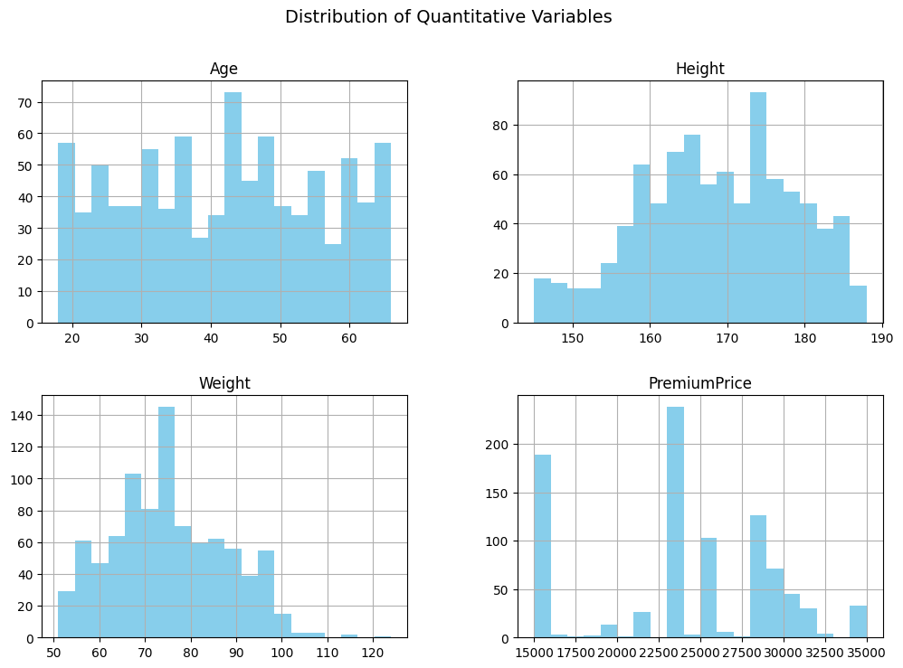
Visual EDA Highlights: Understanding Feature Behavior
Charts summarize distributions, pairwise relationships, and health condition impacts on insurance premiums
Histogram Grid (Age, Height, Weight, PremiumPrice)
What it shows:
All variables look normally spread, no strange outliers.
PremiumPrice is right-skewed, meaning a few people pay very high premiums.
The data looks clean and normally distributed. Premiums are slightly skewed, which is why we later use LogPremium.

Slide 6
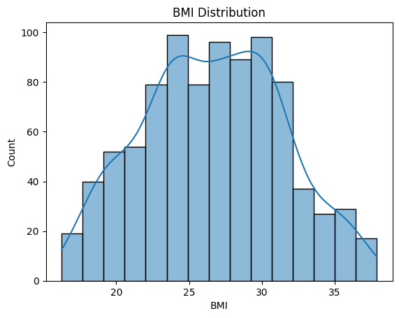
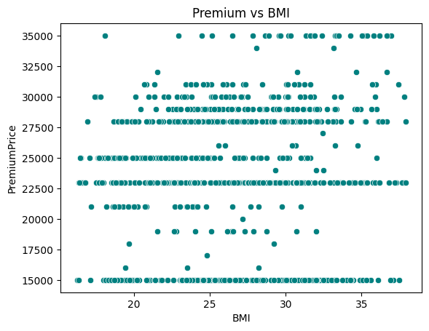
BMI Distribution
What it shows:
Most people fall between BMI 22–32 (mainly overweight range).
Most customers are in the overweight range, so BMI is an important risk factor.
Premium vs BMI Scatterplot
What it shows:
Premiums generally increase as BMI increases, but with some noise.
Higher BMI usually means higher premiums, though the relationship isn’t perfectly linear.

Slide 7
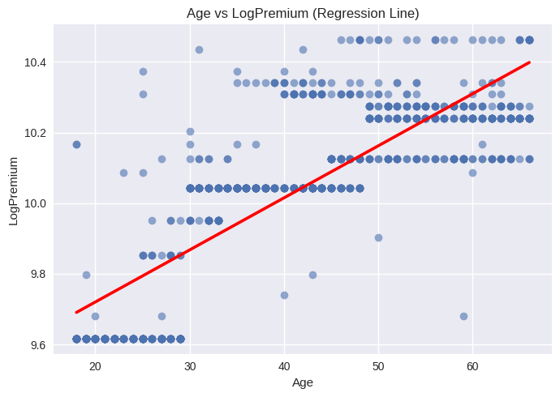
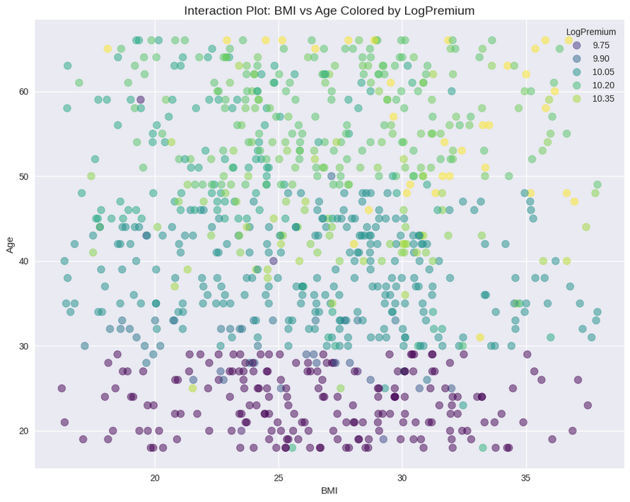
Age vs LogPremium (Regression Line)
What it shows:
Clear upward trend: older individuals pay higher premiums.
Premiums rise steadily with age as expected.
Interaction Plot (BMI vs Age Colored by LogPremium)
What it shows:
Highest premiums appear when both age and BMI are high.
Shows a combined risk effect.
The highest premiums occur for customers who are both older and have higher BMI.

Slide 8
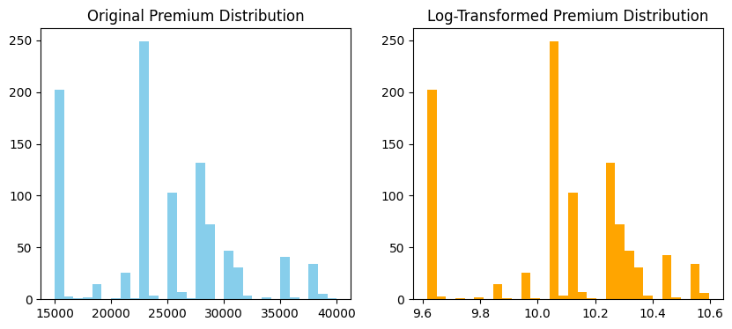
Data Preprocessing
1. Data Cleaning
No missing values in the dataset.
Verified data types for numerical and categorical variables.
Checked ranges for Age, BMI, Height, and Weight.
2. Target Transformation
Applied log transformation to PremiumPrice → LogPremium
Reduced skewness
Improved model fit
Made linear models more stable
3. Encoding Categorical Variables
Binary health conditions (0/1) already suitable.
BMI Category converted to dummy variables.
Feature Engineering
BMI Category
Categorized BMI into: Underweight, Normal, Overweight, Obese
Age Group:Created bins for: 18–25, 26–35, 36–45, 46–55, 56–65, 65+
Bmi- Created new derived feature: BMI = Weight / (Height/100)^2
Weight–Height Ratio -WeightHeightRatio = Weight ÷ Height

Slide 9
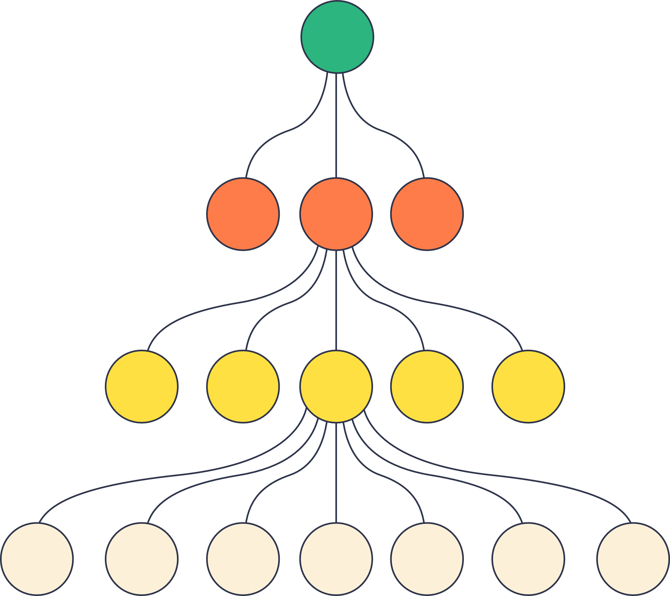
Modeling Approach & Algorithms Used
1. Baseline Model: Linear Regression
Started with multiple linear regression as a baseline.
Helps understand direction + strength of relationships.
Easy to interpret and useful for initial diagnostics.
2. Ordinary Least Squares (OLS) + VIF Check
We applied OLS regression to analyze coefficient significance.
Used Variance Inflation Factor (VIF) to detect multicollinearity.
Several important medical features (Diabetes, BP Problems, Surgeries, BMI, etc.) showed high VIF.
Removing high-VIF features led to:
Loss of critical predictors
Model oversimplification
Drop in accuracy
Key Learning:
Linear models struggled because the dataset contains correlated medical variables → removing them breaks the model.

Slide 10
Why XGBOOST REGRESSOR IS BEST FIT
We began with Linear Regression and OLS, but multicollinearity caused important health predictors to be removed under VIF rules. Since this weakened our model, we pivoted to non-linear ensemble models. Tree-based methods like Random Forest, Gradient Boosting, and finally XGBoost handled interaction effects and multicollinearity better. XGBoost ultimately gave us the best predictive performance.
XGBoost Regressor
Selected as our final model because it:
Manages multicollinearity without removing important predictors
Captures non-linear and interaction effects missed by Linear Regression
Uses regularization to prevent overfitting
Algorithm: XGBRegressor
Hyperparameters: n_estimators = 200, learning_rate = 0.1
For these reasons, XGBoost was used to overcome the issues we encountered with OLS and VIF.

Slide 11
XGBoost Evaluation & Model Performance
Test Set Performance
R² Score: High -0.84 → model explains most variance
MAE: Low- 0.05 → small average error
RMSE: Low - 0.09 → predictions close to actuals
Train vs Test Comparison
Similar R², MAE, RMSE for training and test
No major gap → model is not overfitting
Cross-Validation (5-Fold)
Stable scores across folds
Low standard deviation for:R²(0.85), MAE(0.5),RMSE(0.01)
Confirms robust, consistent model performance

Slide 12
Business Implications & Insights
Our model helps insurers estimate customer risk more accurately by identifying the strongest drivers of premium cost, such as age, BMI, medical history, and surgeries. With more precise premium predictions, underwriting becomes faster and more consistent, reducing manual review time. The model also supports better customer segmentation by highlighting high-risk groups and potential wellness or preventive health opportunities. Overall, this improves pricing fairness, operational efficiency, and risk management for insurance companies.

Slide 13
Conclusion
Our project showed that premium pricing is driven by nonlinear relationships between age, BMI, and medical history, making XGBoost a more effective choice than OLS. The XGBoost model delivered strong, consistent performance across all evaluations and highlighted age, chronic diseases, family cancer history, and surgical history as key predictors. Residuals showed no major bias, and the model generalized well. These insights support more accurate, fairer premium pricing, improved risk segmentation, and data-driven preventive-care strategies for insurers.

Slide 14

Thank you very much!

